Slide 1
Chat bot for booking cinema tickets
Natural language processing

Slide 2
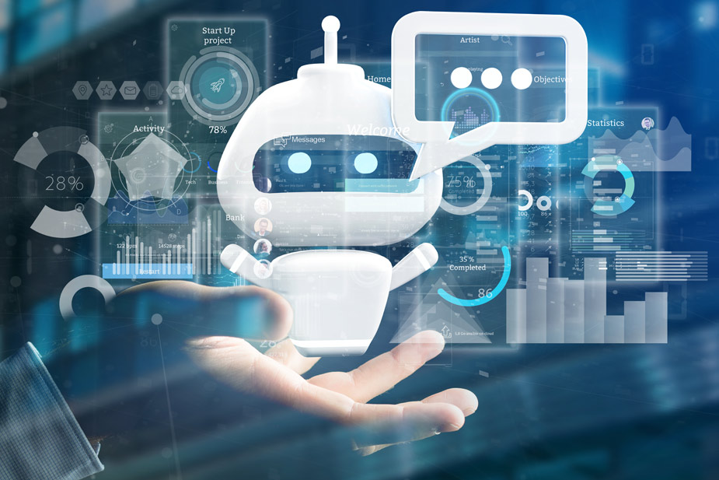
Agenda
Introduction
Abstract
methodology

Slide 3
Introduction
Our chatbot simplifies the process by providing a user-friendly interface for movie enthusiasts to explore showtimes, select seats, and secure their tickets effortlessly. Enjoy a seamless and convenient cinema booking experience with our innovative chatbot. Away from long queues and complicated websites.

Slide 4
Abstract
The Chatbot for Booking Cinema Tickets project aims to revolutionize the way users reserve their cinema tickets by leveraging the power of AI and natural language processing. The chatbot provides a user-friendly and interactive platform where users can effortlessly explore movie listings, check showtimes, select seats, and complete their ticket bookings through a conversational interface.
Gone are the days of navigating complex websites or waiting in long queues. Our chatbot streamlines the ticket booking process, saving users time and effort. With personalized recommendations, real-time information, and intuitive interactions, the chatbot offers a seamless and convenient experience for movie enthusiasts.
The development of the chatbot prioritizes user experience, ensuring that it is intuitive, informative, and reliable.

Slide 5
methodology
model.
Model Development: Train a machine learning model for intent classification using the provided data. Use techniques like bag-of-words representation, lemmatization, and deep learning models to develop a model capable of predicting intents based on user input.
Apply NLP techniques, such as tokenization and lemmatization, to preprocess user input and convert it into a suitable format for the model. Use the nltk library to perform these tasks
Intent Prediction: Implement the predict_class() function, which takes a user's message as input, preprocesses it, and uses the trained model to predict the most probable intent and its associated probability. This function uses bag_of_words representation and model.predict to make predictions.
Requirement Analysis: Identify the requirements and objectives of the chatbot for booking cinema tickets. Determine the desired functionalities, such as intent recognition, response generation, and integration with booking systems.
Data Preparation: Gather and preprocess the necessary data for training and inference. This includes creating or obtaining the intents.json file, which contains patterns, intents, and responses for the chatbot. Additionally, prepare the word data and class labels for training the model.
F

Slide 6
methodology
6. Response Generation: Develop the get_response() function, which takes the predicted intents and randomly selects a response from the corresponding intent's list of responses in the intents.json file. This function ensures that the chatbot provides diverse and appropriate responses based on user inputs.
7. User Interaction: Create a loop that prompts the user for input, calls the predict_class() function to predict the intent, and uses the get_response() function to generate a response. Print the response to the console or display it in a suitable format for the user.
8. Deployment and Testing: Deploy the chatbot code on an appropriate platform, such as a local development environment or a web-based application. Test the chatbot's functionality, accuracy, and performance by interacting with it using various inputs and verifying that the responses are relevant and appropriate.
9. Continuous Improvement: Collect user feedback and analyze the chatbot's performance to identify areas for improvement. Iterate on the code and data based on user suggestions, update movie listings and other relevant data, and enhance the chatbot's capabilities to provide an improved booking experience.

Slide 7
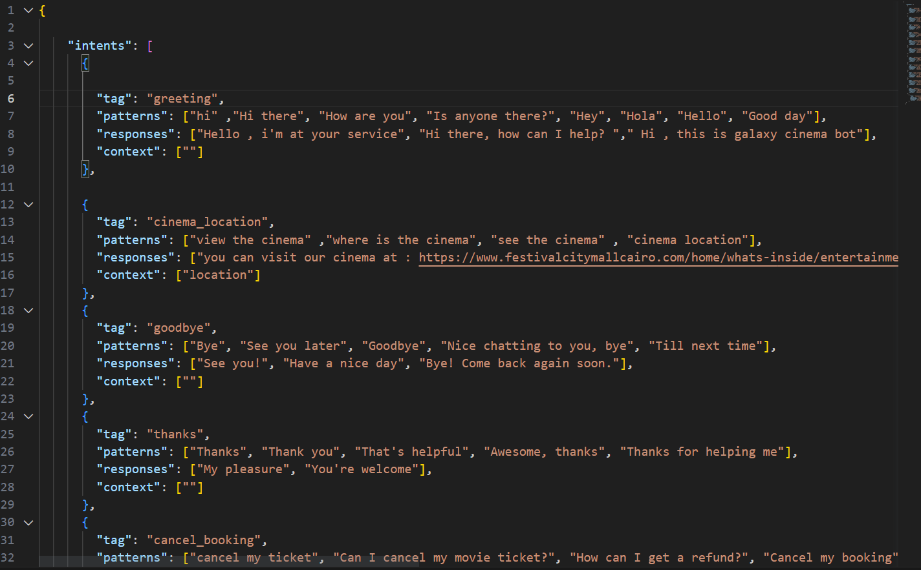

Slide 8
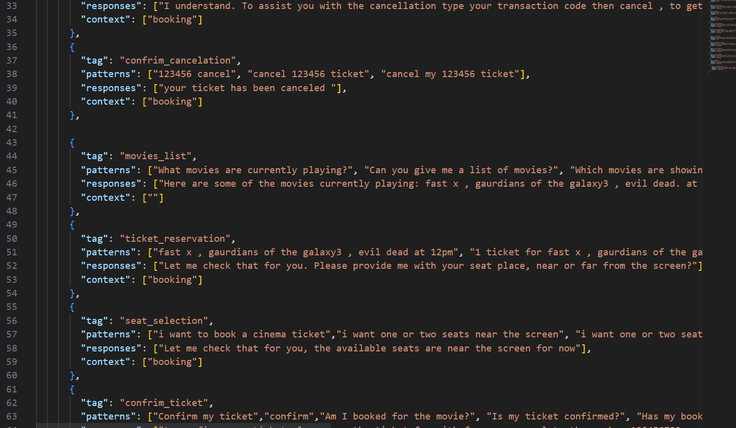
Data:

Slide 9
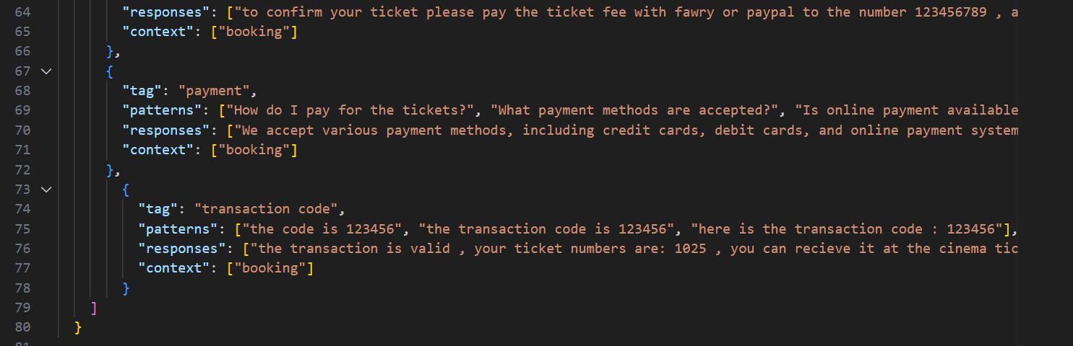
Data:
9

Slide 10
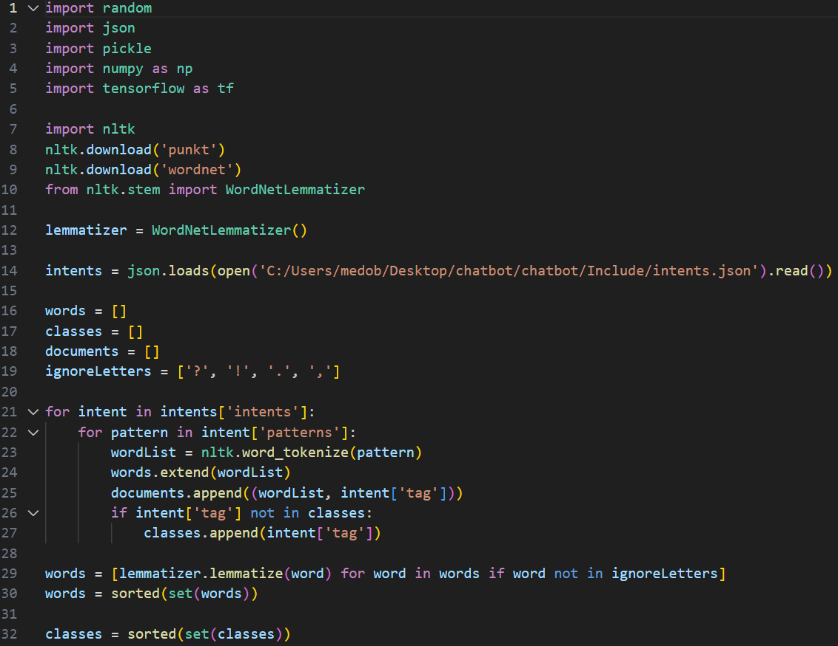

Slide 11
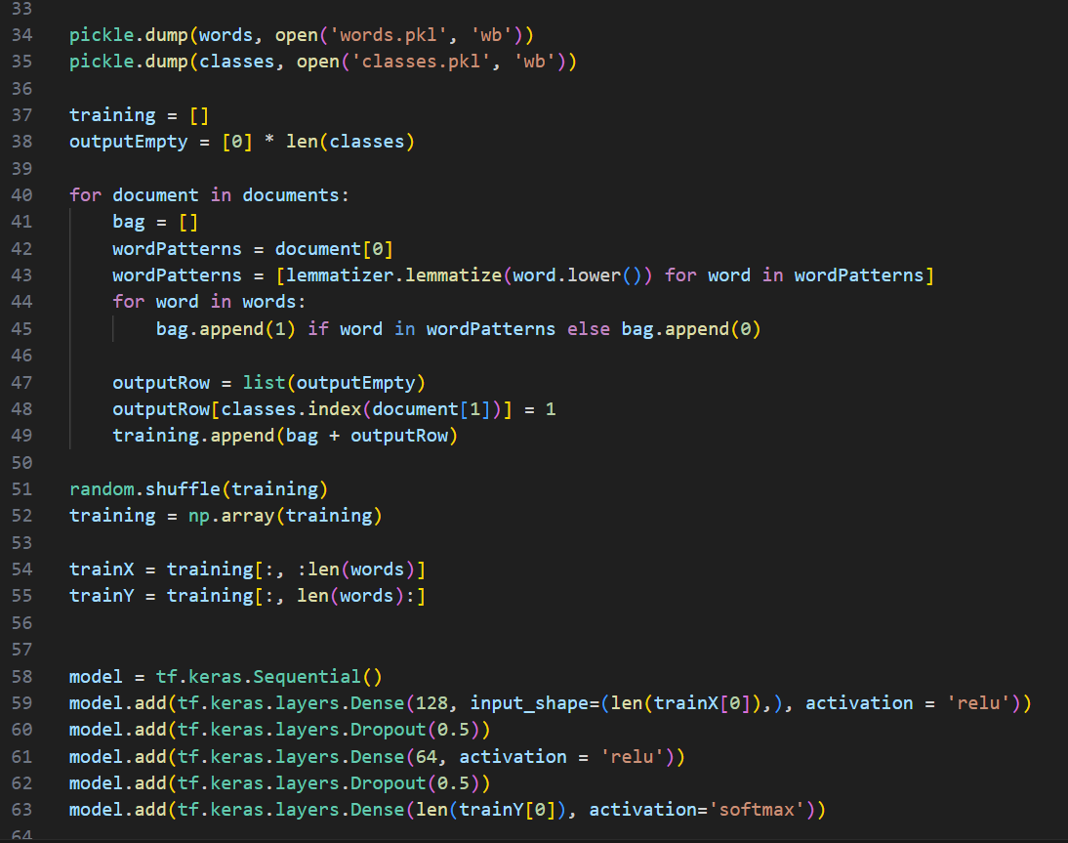

Slide 12
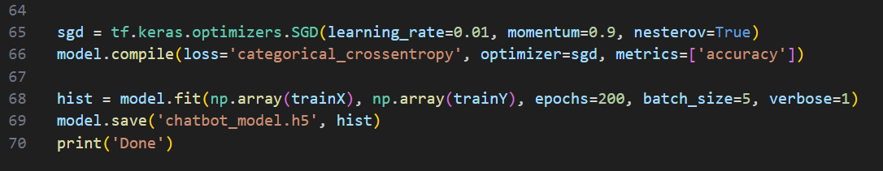

Slide 13
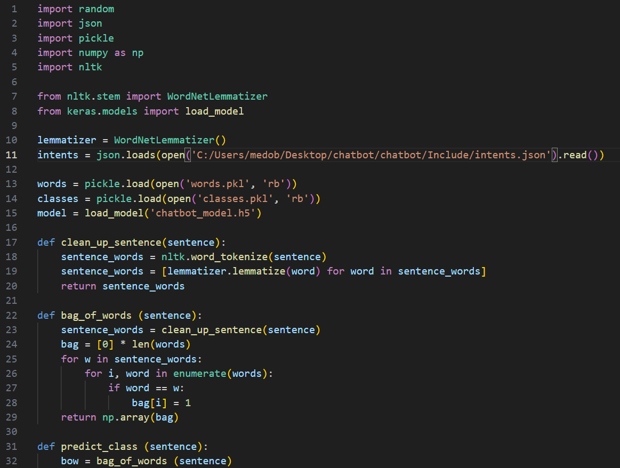

Slide 14
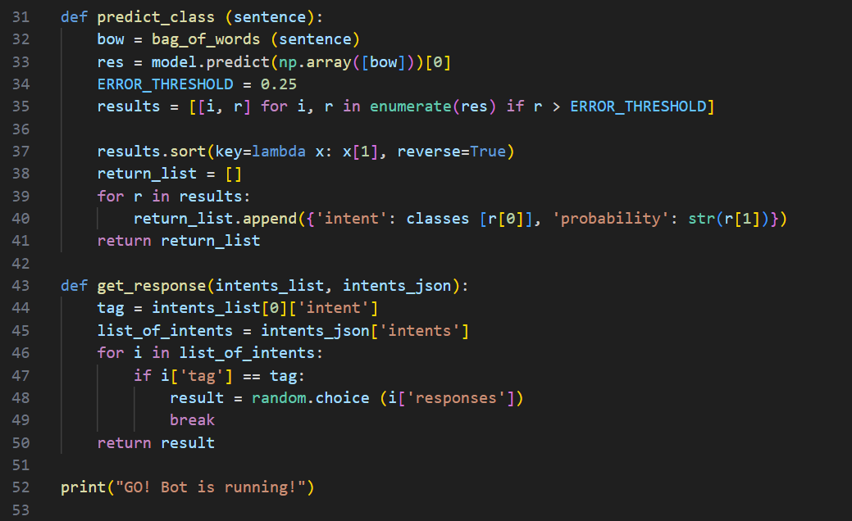

Slide 15
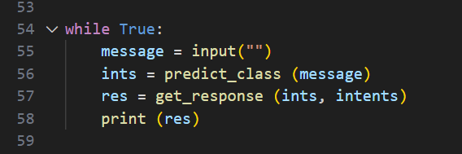

Slide 16
Thank You
OUR TEAM
Nardeen Hesham/ 205074
Mohamed Farouk/ 205011
Amr Khaled/ 205015

